Slide 2
Segment Coalition Meeting
Central Segment
Denver, Colorado - January 22, 2020

Slide 3
Welcome

Slide 4
Agenda
Welcome and introduction
Agenda review and meeting purpose
Project status
Evaluation process
Context
Exercise
Next steps, thank you, and close

Slide 5
Meeting Purpose
The purpose of this meeting is to:
Update segment coalition members regarding Front Range Passenger Rail team action for 2020
Gather coalition members’ input on corridor options

Slide 6
Project Status

Slide 7
Project Status
Governance
Second round of stakeholder engagement
Project development

Slide 8
Evaluation Process

Slide 9
Revised Vision Statement
Developing passenger rail service for communities along the I-25 corridor is a critical component of Colorado’s future.
Front Range Passenger Rail will provide a safe, efficient, and reliable transportation option for travel between major population centers along the Front Range and create a backbone for expanding rail and transit options in the state.

Slide 10
Process
STEP 1
STEP 2
STEP 3
STEP 4
PROJECT INITIATION AND SCOPING
What do we want Front Range Passenger Rail to be?
LEVEL 1 EVALUATION
What are the possibilities for corridors and operations?
LEVEL 2 EVALUATION
How do alternatives compare?
ADVANCE TO NEPA
Federally required process to advance major infrastructure projects
STAKEHOLDER ENGAGEMENT AND GOVERNANCE

Slide 11
Evaluation Criteria Categories
Evaluation Criteria Categories:
Operational characteristics
Community and environmental impact
Financial and economic
Feasibility and implementation
LEVEL 1
FATAL FLAW ANALYSIS
LEVEL 2
COMPARATIVE ANALYSIS
Notes:
More detailed comparative analysis in L2:
Quality of service
Connections to local transportation networks
Multimodal connections
Need for public support
Community impacts and benefits
Economic benefits
Cost
Travel times
Ridership
Competition with auto travel
Opportunities to work with railroads
Train technologies
Stations
Timing, phasing, and completion

Slide 12
Context

Slide 13
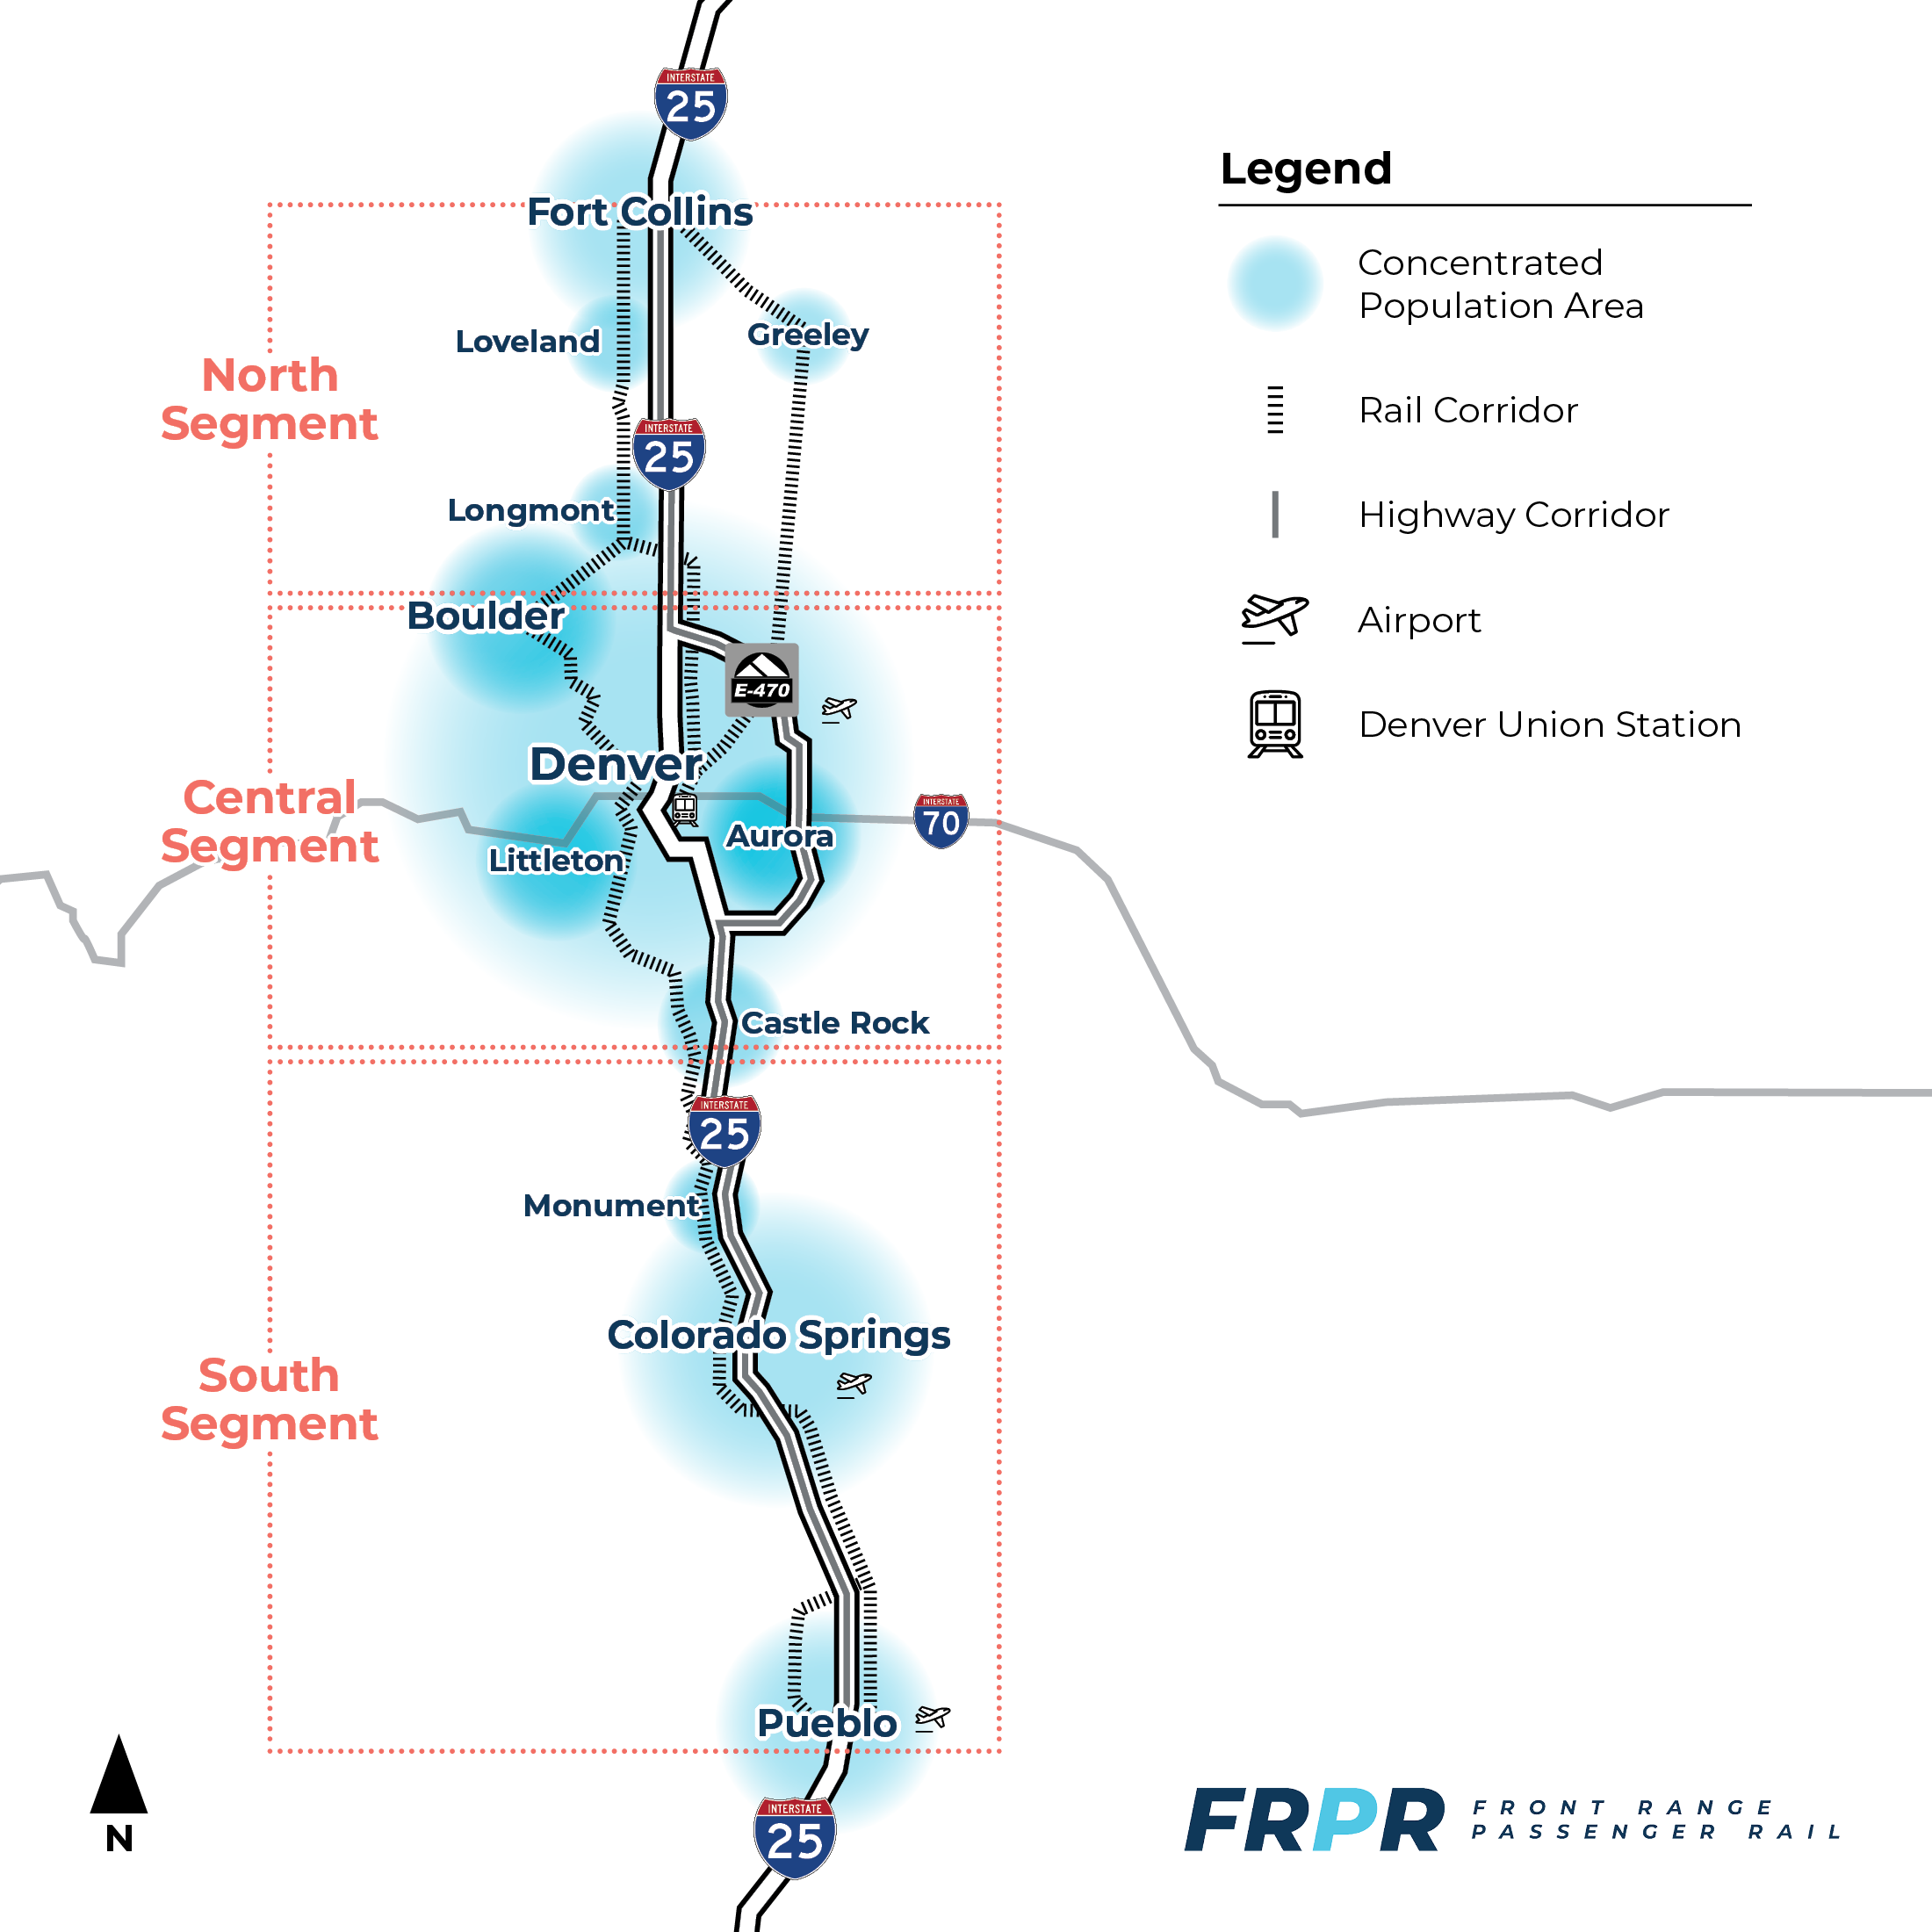
Context
POSSIBLE PASSENGER RAIL CORRIDORS
Highway corridors
Freight rail corridors
Greenfield (new)
Hybrid corridors

Slide 14
Corridors – Opportunities and Challenges
STEP 4
HIGHWAY CORRIDORS
I-25, supplemented by C-470/E-470 and corridors adjacent to rail (US 85)
RAIL CORRIDORS
Union Pacific Railroad and BNSF Railway
Opportunities
Better horizontal geometry
Fewer environmental and community impacts
Potential for reduced right-of-way acquisition
Challenges
Right-of-way constrained
I-25 expansion limited
Rural corridors have less impact, but serve less people
Some vertical curve challenges (grades)
Opportunities
Interest from railroads and Amtrak
Burnham Yard
Corridors align with population centers
Potential to add quiet zones, grade separated crossings, etc.
Challenges
Agreements with railroads
Horizontal geometry for high speeds
Proximity of corridors to communities
Property acquisition
Need for multiple grade separated crossings

Slide 15
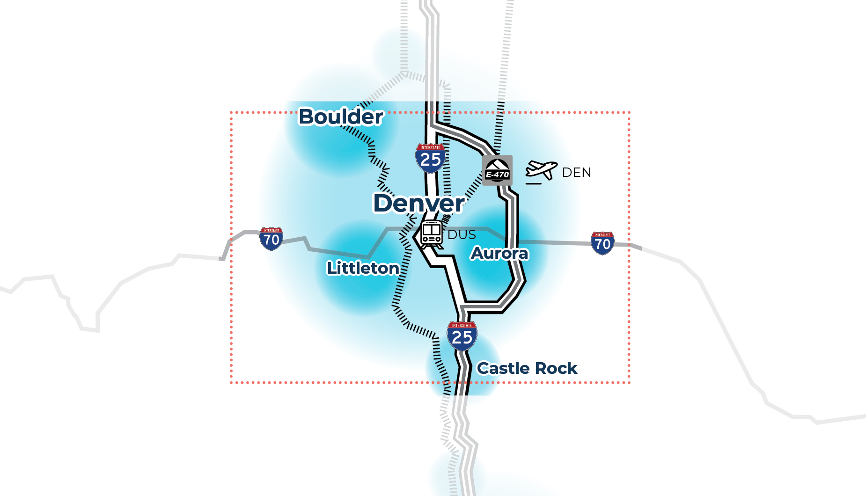
Central Segment-Specific Considerations
Relationship to RTD planned corridors (N Line and B Line)
Serve major destinations (Downtown Denver, Airport)
Access to major events
Constrained right-of-way and community impacts
I-25 vs. US85/BNSF access from south to central Denver
Interaction with RTD
Access to major employment centers
Burnham Yard opportunities and risks

Slide 16
Exercise

Slide 17
Exercise Instructions
20 minutes on your own
Step 1:
Review the context graphics (opportunities and challenges) posted around the room
Step 2:
Note any missing challenges or opportunities
Prioritize your top 5 challenges and opportunities
Provide your ideas for solutions, for example to:
RTD’s corridor extensions (B Line, N Line)
North I-25 Commuter Rail
Connection to Denver Union Station
Note any additional information you think is needed to support your solutions
Step 3:
Complete your notes/questionnaire and be prepared to discuss your ideas with the group
Return your completed questionnaire

Slide 18
Coalition Discussion
Facilitated discussion of your solution ideas:
Missing challenges or opportunities?
Top challenges and opportunities?
Your ideas for solutions?
Additional information you think is needed to support your solutions?

Slide 19
Closing

Slide 20
Next Steps
Summarize:
Key meeting points
Action items
Next meeting
Thank You!

Slide 22
Additional Slides

Slide 23
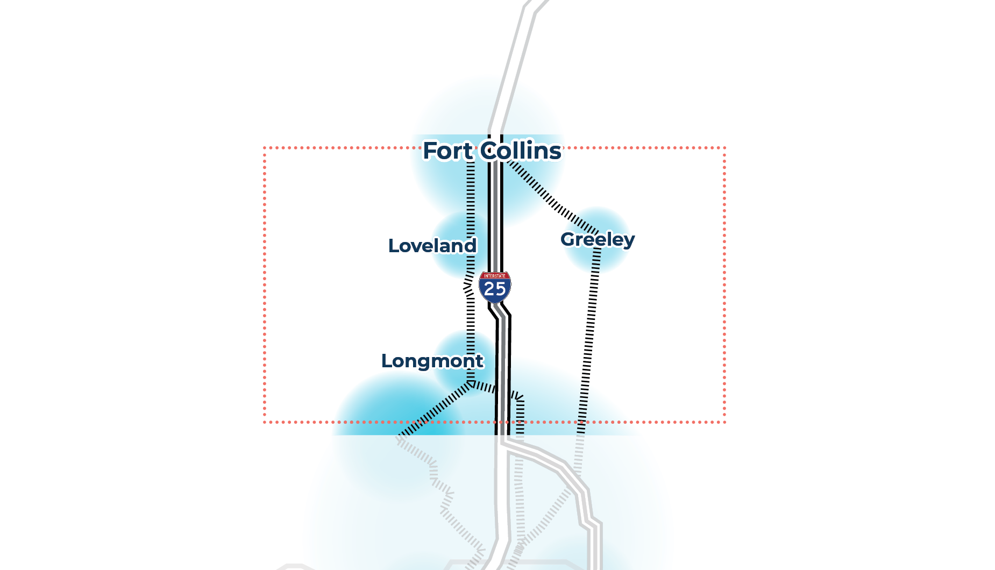
North Segment – Specific Considerations
Interaction with MAX BRT (Fort Collins)
Relationship to I-25 North EIS Commuter Rail
Opportunities to support economic development
Serving populations vs. managing impacts
FNL
Shorter distances between communities
Perceived inequity of transportation investments
Interaction with Bustang

Slide 24
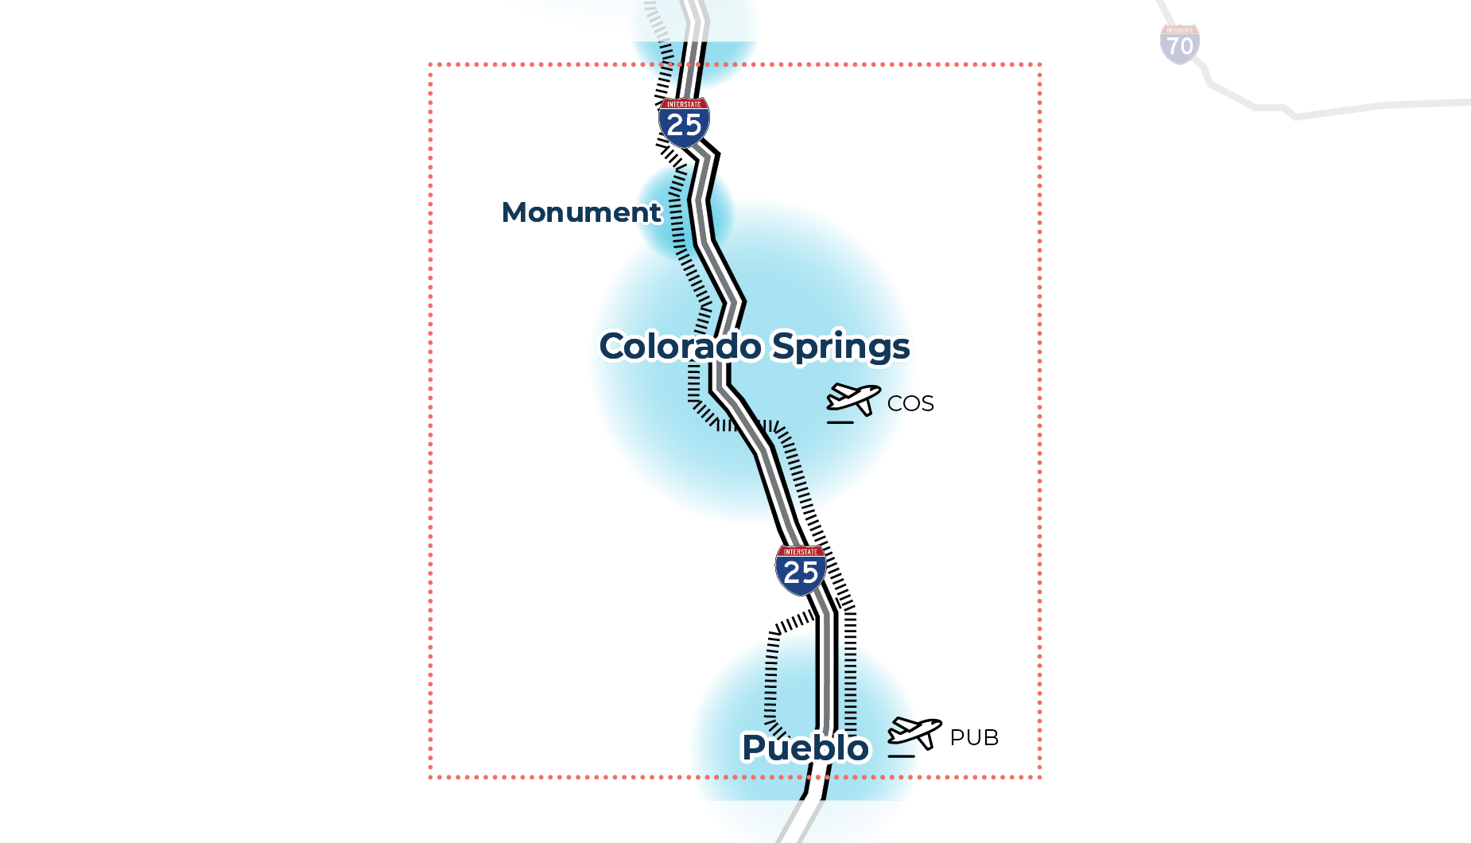
South Segment-Specific Considerations
Topography and greenfield corridors
Interactions with local transit and airports (COS and PUB)
I-25 vs US 85/BNSF access at Castle Rock
Directness of connections to downtown Denver and DEN
Access to Front Range destinations
Access to major employment centers
Access to downtown Colorado Springs

Slide 25
Corridor-Wide System Considerations
DRAFT CRITERIA
Operational Considerations:
Travel Time
Ridership
Operating Speed
Reduction in VMT
Ability to Interconnect with Other Modes (Existing or Planned Transit)
2040 Population Served
Community & Environment Impact:
Community Disruption
Utilities & Energy
Air Quality
Natural Environment
Historic
Hazardous Materials
Recreational Resources
Noise & Vibration
Financial & Economic:
Capital Cost
Operating Cost
Revenue Potential
Cost Effectiveness
Feasibility &
Implementation:
Interaction with Freight Railroad Operations /
Customer Access
Ease of Implementation
Constructability
System Flexibility
Public Support

