Slide 1
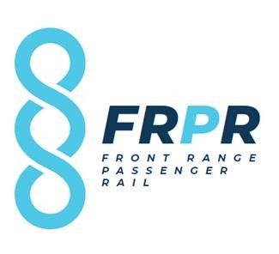

Slide 2
Front Range Passenger Rail
Central Segment Coalition Meeting November 13, 2019

Slide 3
Front Range Passenger Rail is...
An exercise for you to do while we all arrive and settle in. Think of how you would finish this sentence -- free association style:
Write out your thought on a post-it note
Write as many thoughts as you have; one thought per post-it note
Stick your thoughts up on the wall
Look to see others’ thoughts/post-its up on the wall
If there are ideas already on the wall that are similar to yours, group yours next to them
Notes:
Commission Welcome
Introductions: name, org, interest in FRPR or previous engagement in rail studies
Introductions of key project team members
Role of Segment Coalition
Introductory exercise using Post-it notes as attendees arrive, have them finish the sentence “Front Range Passenger Rail is…”

Slide 4
Agenda
Welcome
What is FRPR
Project Development
FRPR Governance
Stakeholder Engagement
Coalition Workshop
Next Steps

Slide 5
Segment Coalition Roles and Expectations
The primary responsibilities of segment coalition members are to provide input on project-related issues and serve as liaisons between the FRPR project and members of their community.
Share information with community members
Provide locally-focused input
Support locally-based engagement
Constructive problem-solvers
Meetings: 2-3 hours; approximately every six weeks
Notes:
To understand local interests, we are forming Segment Stakeholder Coalitions. The coalition consists of experts, advocates, and community members that are charged with providing input on the project’s processes and outcomes. Input from the segment coalitions will be included in the overall project documentation and are a key consideration for decision-making by the project team and Commission.

Slide 6
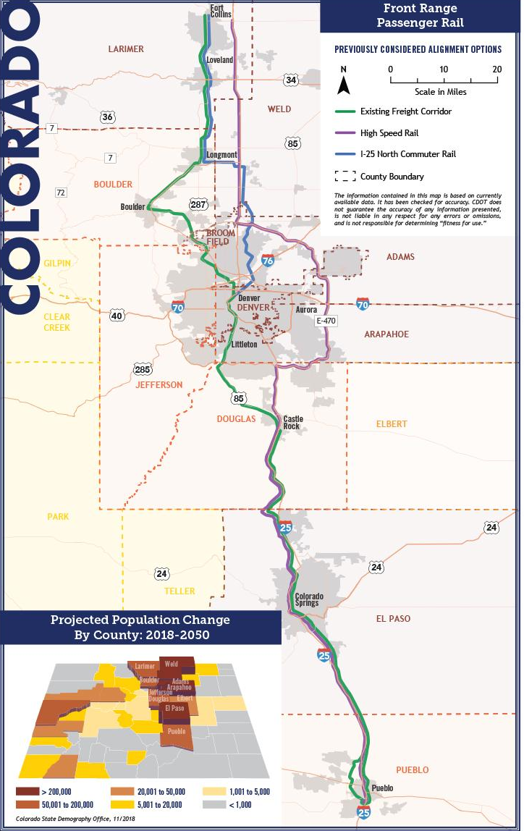
Past Studies
History and Status of FRPR
Numerous studies conducted for passenger rail in Colorado
Across Front Range
State Passenger Rail Plan (2018), Interregional Connectivity Study (2014) and Interoperability Study (2017), Rocky Mountain Rail Authority, High Speed Rail Feasibility Study (2010)
In regional corridors along the Front Range
North I-25 Environmental Impact Statement (2011) and Commuter Rail Update (2015), FasTracks corridors in Denver metropolitan area, Northwest Area Mobility Study (2014), I-25 South Gap Environmental Assessment (2018)
Notes:
Interregional Connectivity Study: Interoperability Report (2017)
Explored operating HST on RTD track through metro Denver. Three alternative alignments were considered, including routes through Denver Union Station (DUS), DEN, and connections between.
The alternative connecting through DEN was determined to best meet project goals based on ridership, travel time, interoperability issues, rail technologies, capital and operating costs.
I-25 South PEL: Monument to 470
Incorporated ICS-recommended passenger rail alignment. Study documented conflicts and potential future considerations for passenger rail.

Slide 7
Who is the Southwest Chief and Front Range Passenger Rail Commission?
Rail Commission
Legislative direction (SB 17-153) to facilitate implementation of passenger rail along the Front Range
Independent Commission, housed under CDOT
11 voting Commissioners
3 non-voting advisors
Groups represented: PPACG, DRCOG, UP, PACOG, NFRMPO, South County Community Member, Passenger Rail Advocates (2), BNSF, SCCOG, RTD, CDOT (non-voting), Amtrak (non-voting), Cheyenne Chamber of Commerce (non-voting)
Notes:
David and Mandy have these slides from FRA presentation
Rail Commission
Legislative direction (SB 17-153) to facilitate implementation of passenger rail along the Front Range
Independent Commission, housed under CDOT
11 voting Commissioners
3 non-voting advisors
Groups represented: PPACG, DRCOG, UP, PACOG, NFRMPO, South County Community Member, Passenger Rail Advocate, BNSF, SCCOG, RTD, CDOT (non-voting), Amtrak (non-voting), Cheyenne Chamber of Commerce (non-voting)

Slide 8
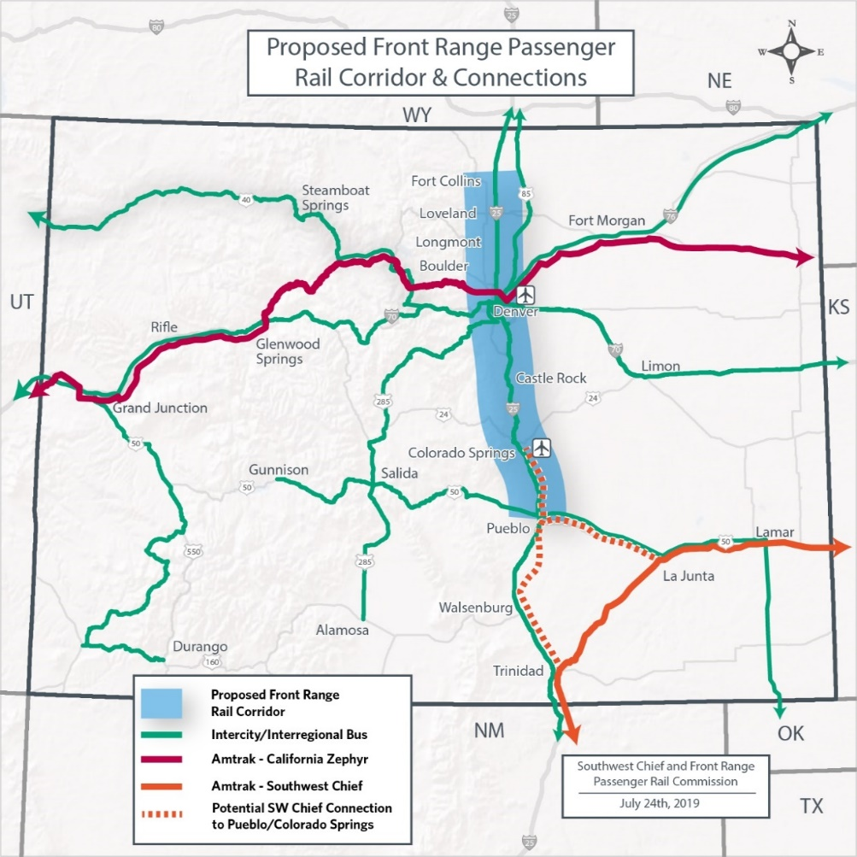
Corridor / Study Area
Notes:
David and Mandy have these slides from FRA presentation

Slide 9
FRPR Purpose
Developing passenger rail service in and along the I-25 corridor is an important component of Colorado’s transportation future. Front Range Passenger Rail (FRPR) will provide a safe, efficient, and reliable transportation option for travel between major population centers along the Front Range and create a backbone for expanding rail and transit options in the state.

Slide 10
FRPR Study Objectives
Increased mobility choices for safe and reliable travel along the Front Range - limited intercity transit options today
Connect corridor destinations and communities - jobs, shopping, recreation, health care, leisure
Address increasing intercity and regional travel demands - effects of population growth and increasing congestion on major highways
Provide a mode choice for our changing demographics and corresponding transportation demands
Provide an inter-city transportation alternative for low-income and underserved communities - connect affordable housing to jobs
Notes:
Following Slides 7 - 9:
Plenary discussion regarding project parameters and questions?
Do you agree with the purpose, needs, goals? What else would you add?
Outcome: get concurrence or suggestions for purpose and objectives

Slide 11
Project Development
Decision-Making Process

Slide 12
Governance
Public Rail Authority: Establishes a statutory tool for local entities to create an authority over time as planning and funding options arise. This tool is similar to PHA and RTA enabling statutes but for rail. (Preferred)
Front Range Rail District: Creates a defined district along the I-25 corridor and provides a specific governance structure; powers and financing authority would be detailed in statute.
Rail Enterprise: Could leverage HPTE structure, focused more on fees for funding; powers and financing authority would depend on statute.
Expand SW Chief/FRPRail Commission: Provide additional scope and authority to existing Commission to further evaluate above options, along with appropriation.
Notes:
Governance Overview
Current Governance Options To-Date
Governance Next Steps
Commission, CDOT, and stakeholders beginning to discuss/evaluate possible legislative options for the January 2020 Legislative Session
Potential legislative options address funding & governance for passenger rail, and future Commission funding

Slide 13
Stakeholder Engagement
Overview of Engagement Approach
FRPR Presentations
Stakeholder Interviews
Social and Political Risk Assessment
Online Engagement
Community Meetings
Stakeholder Coalitions
Notes:
Online Engagement
Contact Database (Zoho)
Online Surveys
Project Email
Project Notifications (E-Blasts)
Project Website
Project Videos
Online / Virtual Meetings
Social Media

Slide 14
Stakeholder Engagement
Segment Stakeholder Coalitions (North, Central, South)
Function: Provide project information to and obtain feedback at the local level
Members: Regional and local stakeholders
Responsibilities: Share project information with segment communities; Gather community input and share with Corridor Stakeholder Coalition
Frequency: Approximately every six weeks
Corridor Stakeholder Coalition
Function: Create stakeholder-based recommendations for cohesive, corridor-wide project decisions
Members: Segment Stakeholder Coalition representatives
Frequency: Quarterly
Notes:
Online Engagement
Contact Database (Zoho)
Online Surveys
Project Email
Project Notifications (E-Blasts)
Project Website
Project Videos
Online / Virtual Meetings
Social Media

Slide 15
Stakeholder Engagement
Past Studies Public Input Themes
Thinking about the state’s future transportation system differently is wise
Need alternative modes of transportation
Traffic congestion is getting worse, and paving more lanes is not the answer
Need for more expansive local transit systems to provide connectivity to Front Range system
Preference for scenarios with fastest travel times
Phasing smaller phases will be hard to garner broad support or public enthusiasm
Concerns about
Construction and operation costs and how to pay for them (concerns about tax increases)
Appropriateness of passenger rail for Colorado given lower population densities and car culture
Notes:
Use summary from past studies

Slide 16
Stakeholder Engagement
Past Studies Public Input Themes
Notes:
Use summary from past studies

Slide 17
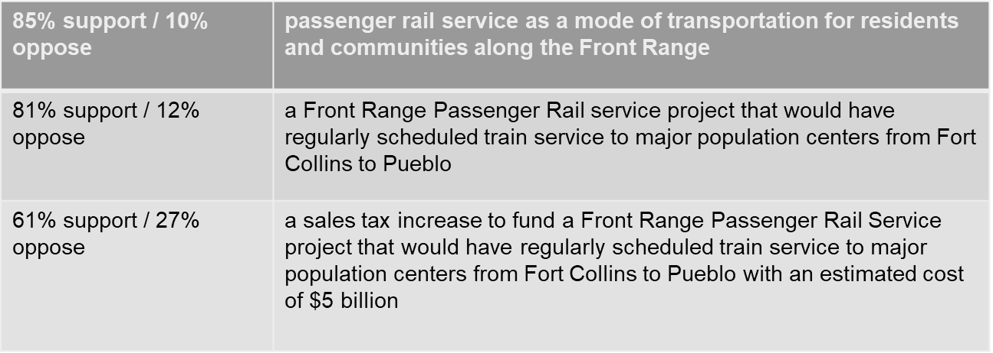
Stakeholder Engagement
MetroQuest Online Survey
6,965 respondents
95% believe passenger rail could help address transportation needs along the Front Range
Public Opinion Survey
600 responses
Notes:
Online MetroQuest Survey
6,965 total respondents over 71 days; July 22nd—September 30th, 2019.
95% of respondents believe that passenger rail service could help address transportation needs along the Front Range.
93% support establishing passenger rail between at least Fort Collins and Pueblo.
92% would be interested in using the service if it were available.
RBI/Magellan Survey
600 responses across the 13 Front Range counties - October 4th-8th
85% total support (10% total oppose) passenger rail service as a mode of transportation for residents and communities along the Front Range.
81% total support (12% total oppose) a Front Range Passenger Rail service project that would have regularly scheduled train service to major population centers from Fort Collins to Pueblo.
61% total support (27% total oppose) a sales tax increase to fund a Front Range Passenger Rail Service project that would have regularly scheduled train service to major population centers from Fort Collins to Pueblo with an estimated cost of $5 billion.
Based on a limited number of respondents More than 80 percent of Front Range residents support the concept and would use passenger rail if it was available
Top reasons for support
Reduce traffic congestion
Provide an alternate mode
Reduce emissions
Improve access to jobs and economic opportunities (particularly in south)
Addressing impacts of growth and improving roads and transportation system is one of the most important issues for Front Range voters (after health care and education)

Slide 18
Stakeholder Engagement
What have we heard?
Issues
Connect to Local Network
Be “Future Flexible”
Speedy and Efficient Service
Support Future Development
Concerns
Cost Prohibitive (to build/operate)
Cannot Compete with Cars (Time, Ease, Cost, Culture)
Distrust / Historical Problems
Low ridership
Notes:
Online MetroQuest Survey
6,965 total respondents over 71 days; July 22nd—September 30th, 2019.
95% of respondents believe that passenger rail service could help address transportation needs along the Front Range.
93% support establishing passenger rail between at least Fort Collins and Pueblo.
92% would be interested in using the service if it were available.
RBI/Magellan Survey
600 responses across the 13 Front Range counties - October 4th-8th
85% total support (10% total oppose) passenger rail service as a mode of transportation for residents and communities along the Front Range.
81% total support (12% total oppose) a Front Range Passenger Rail service project that would have regularly scheduled train service to major population centers from Fort Collins to Pueblo.
61% total support (27% total oppose) a sales tax increase to fund a Front Range Passenger Rail Service project that would have regularly scheduled train service to major population centers from Fort Collins to Pueblo with an estimated cost of $5 billion.

Slide 19
Stakeholder Engagement
Interactivity
How will FRPR benefit your region/community?
What aspect of FRPR is most important to you?
What are the challenges to implementing FRPR?
How does FRPR fit into a larger mobility picture?
What are FRPR success factors?
Notes:
Get coalition member input on (1) how FRPR will benefit their region, (2) Project Process and Engagement Approach, (3) Alternatives, (4) Purpose and Need, and (5) Local Issues
Have a station for each item, members rotate through, providing input
Station leads report out key findings to full group

Slide 20
Front Range Passenger Rail Is...
Notes:
Post-It Note Exercise

Slide 21
Next Steps
Request for Information
Select Corridor Coalition Representatives
Next Segment Coalition Meeting
Level 1 Alternatives

Slide 22
Thank you for joining us!

